Slide 1
AFTA-WFIRST Coronagraph Instrument
Status Report -- ExoPAG
Feng Zhao
AFTA Coronagraph Instrument Manager
1/5 2014
Copyright 2013 California Institute of Technology. Government sponsorship acknowledged

Slide 2
Outline
Introduction
Newly selected architecture description
Status and next steps
Summary

Slide 3
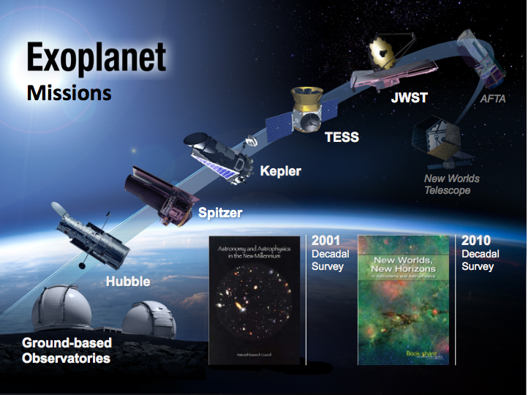

Slide 4
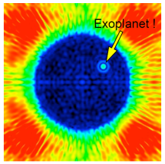
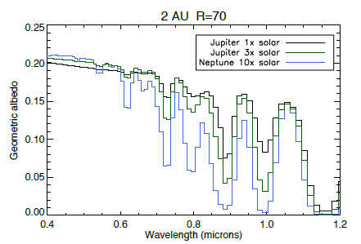
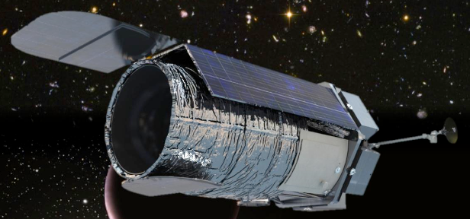
AFTA Coronagraph Instrument
Coronagraph
Instrument
Exo-planet
Direct imaging
Exo-planet
Spectroscopy
Bandpass | 430 – 980nm | Measured sequentially in five ~10% bands
Inner working angle | 100 – 250 mas | ~3λ/D, driven by science
Outer working angle | 0.75 – 1.8 arcsec | By 48X48 DM
Detection Limit | Contrast ≤ 10⁻⁹ After post processing) | Cold Jupiters, not exo-earths. Deeper contrast looks unlikely due to pupil shape and extreme stability requirements
Spectral Resolution | ~70 | With IFS, R~70 across 600 – 980 nm
IFS Spatial Sampling | 17mas | Nyqust for λ~430nm
AFTA Coronagraph Instrument will:
Characterize the spectra of over a dozen radial velocity planets.
Discover and characterize up to a dozen more ice and gas giants.
Provide crucial information on the physics of planetary atmospheres and clues to planet formation.
Respond to decadal survey to mature coronagraph technologies, leading to first images of a nearby Earth.

Slide 5
Functional Block Diagram
Star light suppression optics
1kX1K, Si low noise FPA; 150K, IWA 0.25/λ arcsec, OWA 2.5/λ arcsec, λ(0.43-0.98um)
High contrast loop during initialization
Coronagraph FPA
OTA
(PM, SM)
TM, relay, FSM
DM #1,
DM #2
Relay, Occulting Masks & Filters
Post processing
Telemetry
LOWFS
IFS
IFS FPA
LOWFS
FPA
2kX2k, Si low noise FPA; 150K, λ(0.6-0.98um), R~70, 17mas sampling
Drift control loop (<2Hz)
Optics
Jitter control loop
(250Hz?)
Control
Detector
Post processing on ground

Slide 6
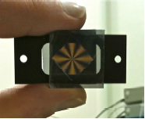
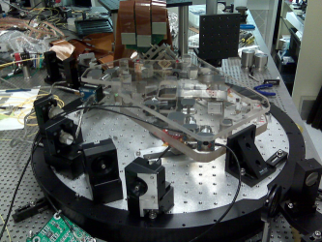
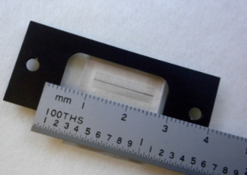
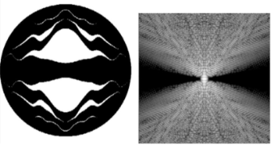
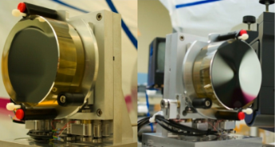
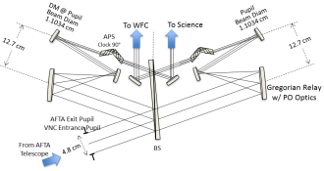




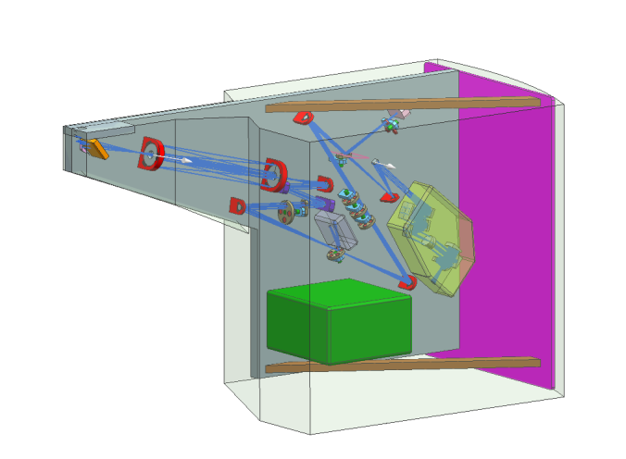
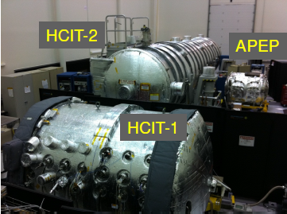
Star light suppression -- Technical Approach
Six different concepts
Visible Nuller Coronagraph: Phase-Occulting (Lyon, GSFC)
Visible Nuller Coronagraph: DaVinci (Shao, JPL)
Down select 12/15/2013
http://wfirst.gsfc.nasa.gov/
Primary Architecture (OMC) | Back-up Architecture (PIAACMC)
TRL-5 @ start of Phase A (10/2016)
TRL-6 @ PDR (10/2018)

Slide 7
















Primary Architecture:
Occulting Mask Coronagraph = Shaped Pupil + Hybrid Lyot
  SP and HL masks share very similar optical layouts
  Small increase in over all complexity compared with single mask implementation
Pupil mask changer
Occulting mask changer
Lyot
mask changer
Pupil mask changer
Lyot
mask changer
Occulting mask changer
(magnified for illustration)
DM1/FSM
HL
c
FPA
DM2
To LOWFS
c
SP
DM1/FSM
FPA
……
DM2
λ₁
λ₂
λ_{n}
To LOWFS

Slide 8
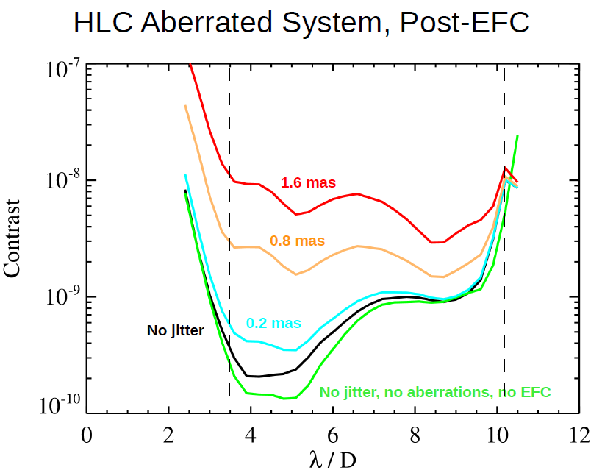
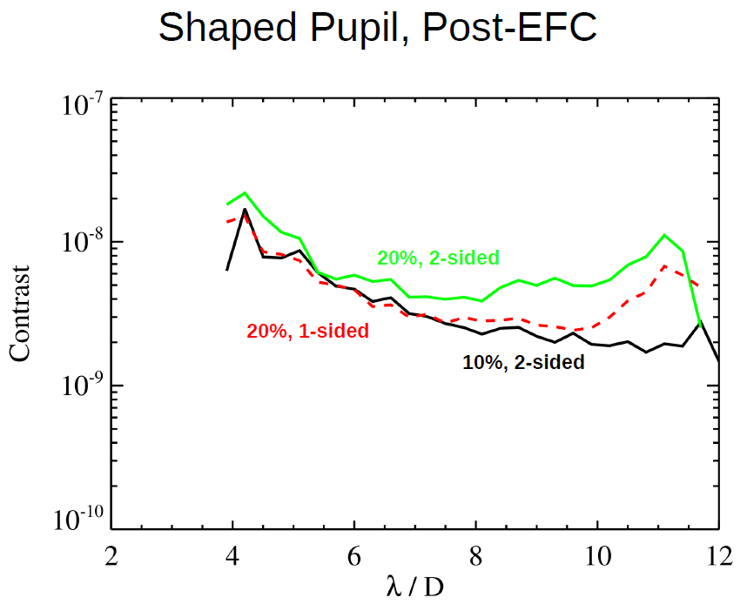
Contrast simulations with AFTA pupil, aberrations and expected range of telescope pointing jitter
  OMC in its “SP mode” provides the simplest design, lowest risk, easiest technology maturation, most benign set of requirements on the spacecraft and “use-as-is” telescope. This translates to low cost/schedule risk and a design that has a high probability to pass thru the CATE process.
  In its “HL mode”, the OMC affords the potential for greater science, taking advantage of good thermal stability in GEO and low telescope jitter for most of the RAW speed
(Insensitive to jitter)
λ=550nm
Good balance of science yield and engineering risk

Slide 9
Observatory Pointing Jitter Estimate
The results indicate telescope LOS jitter less than 1 mas over a wide range of wheel speeds, before LOWFS tip/tilt correction.
  Except at wheel speed ~10 and 26 rps
Numerous opportunities exist for further jitter optimization:
  operational constraints,
  momentum management strategies,
  structural redesign,
  LOWFS design optimization
RWA operation range
“Model uncertainty factor (MUF)” consistent with flight projects (MUF=2.5 for f<20Hz, and MUF=6 for f>40Hz, linear in between)

Slide 10
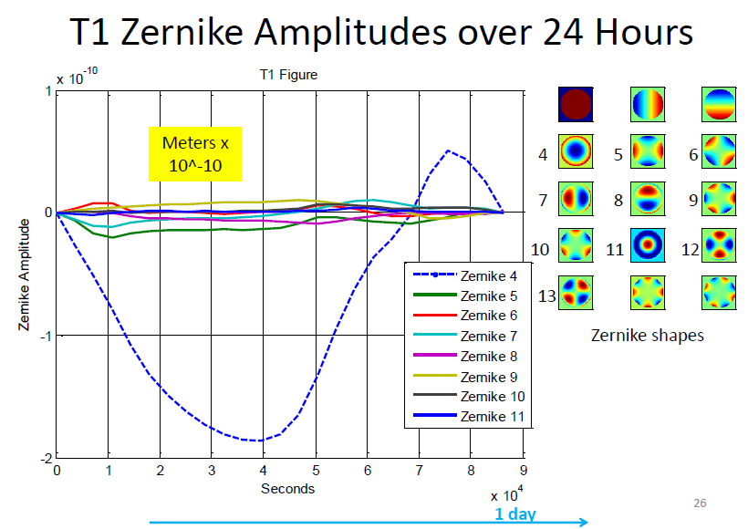
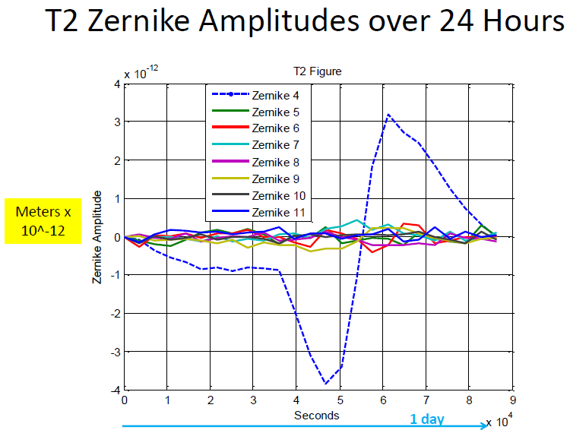
Telescope Thermal Stability Estimate
Recent STOP model results indicate very stable telescope wavefront during operation
  Dominant term is focus, ~2nm over 24 hrs
  Other low-order WFE <20pm over 24 hrs

Slide 11
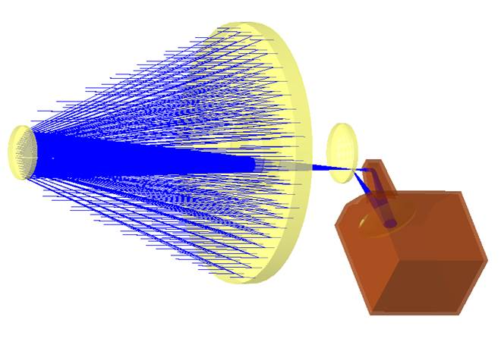

Instrument Layout within the Allocated Envelope
Allocated envelope
From OTA
Enough space for PIAA bench
Lyot
Mask
Changer
Fold
Occulting
Mask
Changer
Flipper
mirror
FSM
TM
DM1
DM2
Pupil
Mask
Changer
Instrument
Elex
IFS
Fold
Imaging
FPA
(1) Main OMC Bench
(1)
(2)
(2) Detector Bench

Slide 12
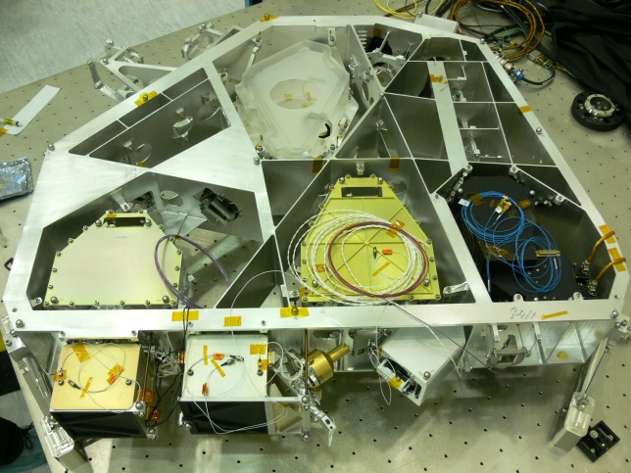
Functional Modularized Instrument
Tertiary Module
DM Module
CoronagModule
IFS Module
Imager Module
Elex Module
PIAA (optional)
Functional
Testing
Functional
Testing
Functional
Testing
Functional
Testing
Functional
Testing
Functional
Testing
Functional
Testing
Coronagraph Bench
Modularized Instrument:
Simple interface (collimated beam)
Flexible early EDU risk mitigation
Shorter flight I&T duration
Ease of international participation
Functional Testing
Performance Testing
Environmental Testing
Functional Testing
Payload I&T
Modularized example (SIM ABC)

Slide 13
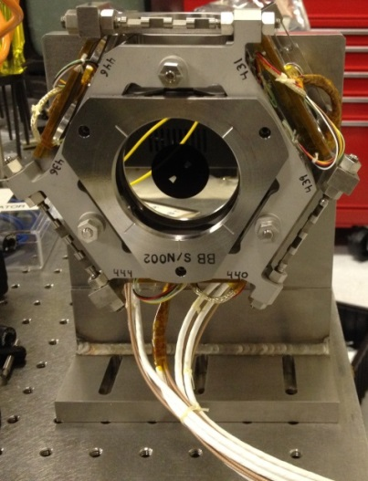
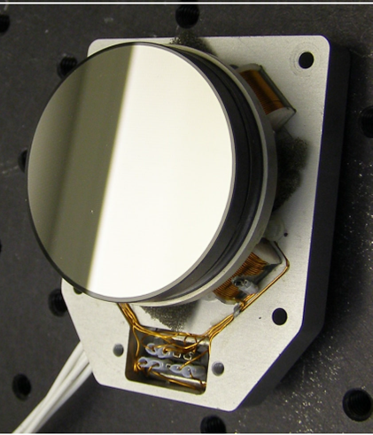
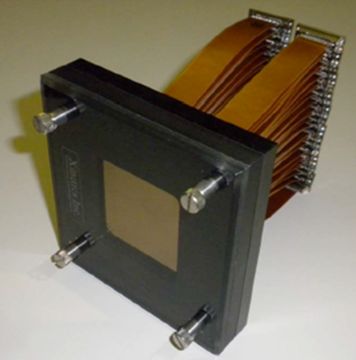
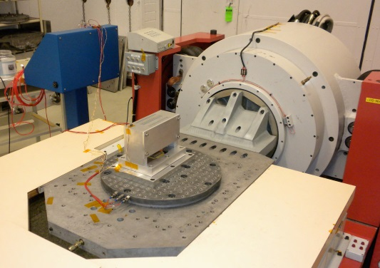
Active Optics
Fine Steering Mirror (FSM)
To correct telescope line-of-sight (wavefront tip/tilt) error
Low risk with rich flight heritage
Deformable Mirror (DM)
To correct telescope & instrument optical WFE (static and drift)
Low risk with good heritage:
  Flight PMN actuators, driver electronics
  HCIT contrast demonstration to 10⁻¹⁰
  Assembly passed random vibe test (2012)
Low risk for flight implementation

Slide 14
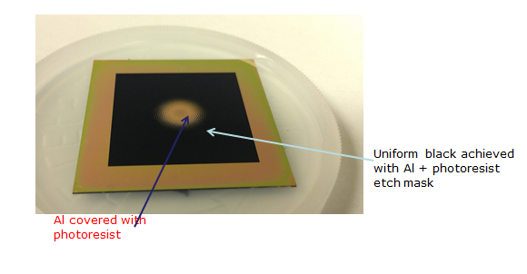

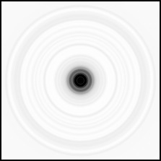
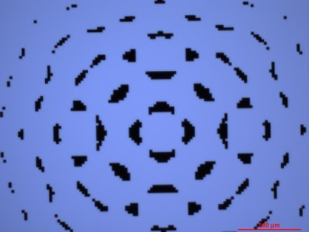
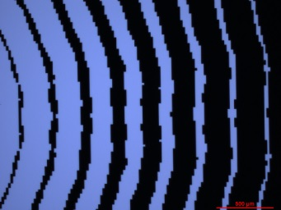
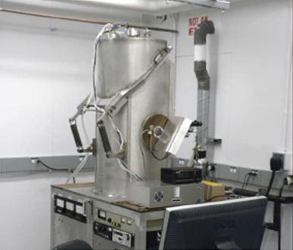
Coronagraph Masks
Reflective shaped pupil masks
Black Si on Al mirror coating demonstrated at JPL/MDL and Caltech/KNI
Transmissive hybrid Lyot mask
Profiled Ni layer (amplitude) over-coated with profiled MgF2 layer (phase) at JPL Trauger’s lab
Linear mask fabricated and demonstrated 10⁻¹⁰ in HCIT for un-obscured pupil
AFTA
Both masks have credible plan for FY14 delivery to HCIT

Slide 15
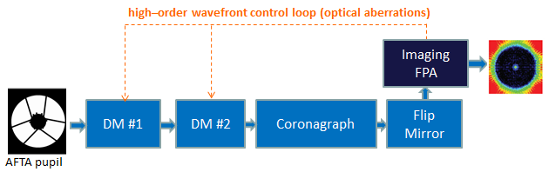
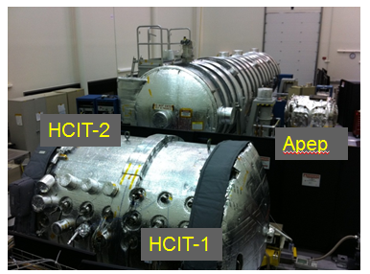
System-Level Testbed Demonstration
Phase 1: Static Wavefront
Possible Path to Closing Gap
Demonstrate static wavefront performance in fully-assembled coronagraph vacuum testbed with simulated AFTA-WFIRST telescope pupil.
Simulated light from star
Key Demonstration Objectives
Coronagraph masks/apodizers for AFTA-WFIRST obscured pupil
Two-DM configuration
Wavefront control algorithms developed
Static wavefront performance:
  1e-8 contrast
  2% → 10% BW (in 500-600 nm window)

Slide 16
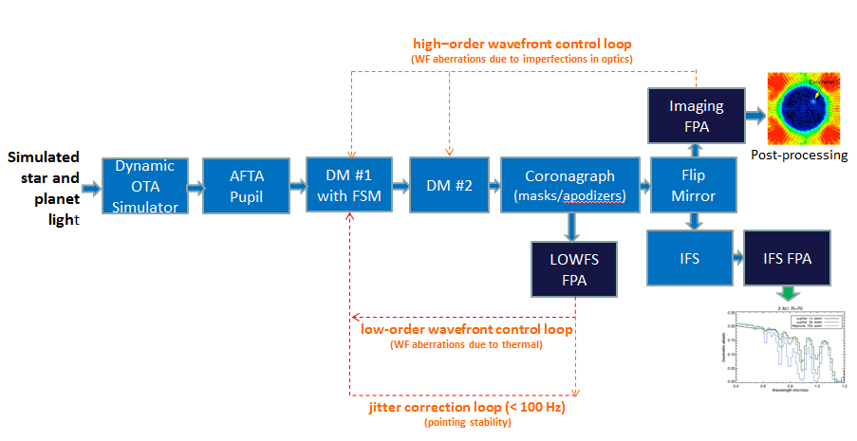
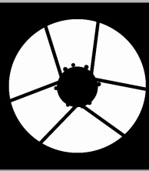

System-Level Testbed Demonstration
Phase 2: Dynamic Wavefront
Possible Path to Closing Gap
Demonstrate dynamic wavefront performance in fully-assembled coronagraph vacuum testbed with simulated AFTA-WFIRST telescope pupil in a dynamic env’t.
Key Demonstration Objectives (TRL 5)
Dynamic OTA simulator
DM/FSM integrated assembly
LOWFS/C and algorithms developed
Dynamic wavefront performance:
  1e-8 raw contrast
  1e-9 detection contrast
  2% → 10% BW (central wavelength of 550 nm)
  IFS (R~70 TBD) separately
Planet simulation and extraction
Post-processing

Slide 17
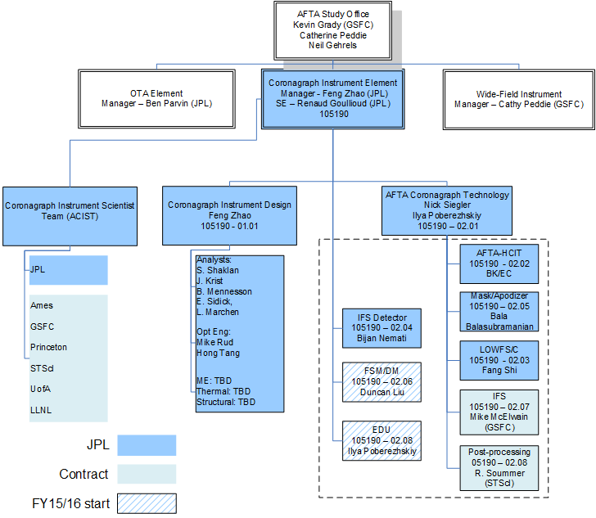
Org Chart
Negotiation with instrument scientist underway

Slide 18
Next Steps
Technology Maturation:
  Submit technology maturation plan to HQ with milestones FY14-FY16 (TRL-5 demonstration by 10/2016)
AFTA-WFIRST DRM:
  SDT interim report 4/2014
  SDT final report 1/2015
  CATE 2/2015
Wider community participation
  ACIST
  International partnership

Slide 19
Summary
Exciting coronagraph technology maturation for a generic telescope (such as AFTA)
  Benefit future exo-Earth imaging missions using a generic telescope (such as ATLAST)
AFTA-WFIRST Occulting Mask Coronagraph offers balanced science returns and engineering risks
Strong interest from community and international partners, modularized instrument design offers simple interface and flexible contributions

Slide 20









Acknowledgement
Contributions from team members from JPL, GSFC, Princeton, Univ of Arizona, Ames, LLNL, STScI, Caltech

